Slide 1
Welcome to Postgraduate Business Courses​
SBASE1, SBASL1, UBASE1
Faculty of Arts and Society, Business & Accounting
Dr Debajyoti Chakrabarty
29th February 2024

Slide 3
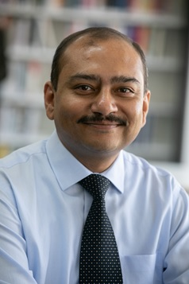
Dr Debajyoti Chakrabarty
Course Coordinator Postgraduate Business
Email: debajyoti.chakrabarty@cdu.edu.au
Phone: 02 8047 4117
Notes:
Welcome to the Bachelor of Business course
My name is Ulrike Kachel, and I am your course coordinator
This means, that if you have any questions relating to the course, majors, study plans, etc. while studying with us, then I can advise you.
Today, I’m going to briefly provide an overview of what the Bachelor of Business course entails – feel free to ask any questions.

Slide 4
Student Central
www: https://www.cdu.edu.au/student-central​
E: student.central@cdu.edu.au​ FAQs: Ask CDU​ 1800 061 963 (freecall)​ Mon - Thurs: 8:30am - 4pm​ Friday: 8:30am - 3pm

Slide 5
Course Aim
Our industry-focused MBA courses help you develop business skills to run organisations of all sizes that operate profitably and in a manner that supports society, the economy, and the environment. You will study units focusing on sustainable enterprise, design thinking for sustainable innovation, economics, global market and sustainability strategy, business analytics and management.

Slide 6
What you will learn
Apply business knowledge, principles and theories to develop profitable and sustainable local and global organisations.
Apply business research skills to identify complex organisational challenges in a global sustainability context.
Develop organisational strategies for managing threats and taking advantage of market opportunities while optimising sustainability outcomes.
Communicate effectively with a range of internal and external stakeholders.

Slide 7
Study Plans
cdu.edu.au/study/business
Remember, not all units are available each semester
Normal full-time study load: 40 credit points (usually four units) every semester
You can find your timetable via the study plan page (lecture times/location and lecturer)

Slide 8
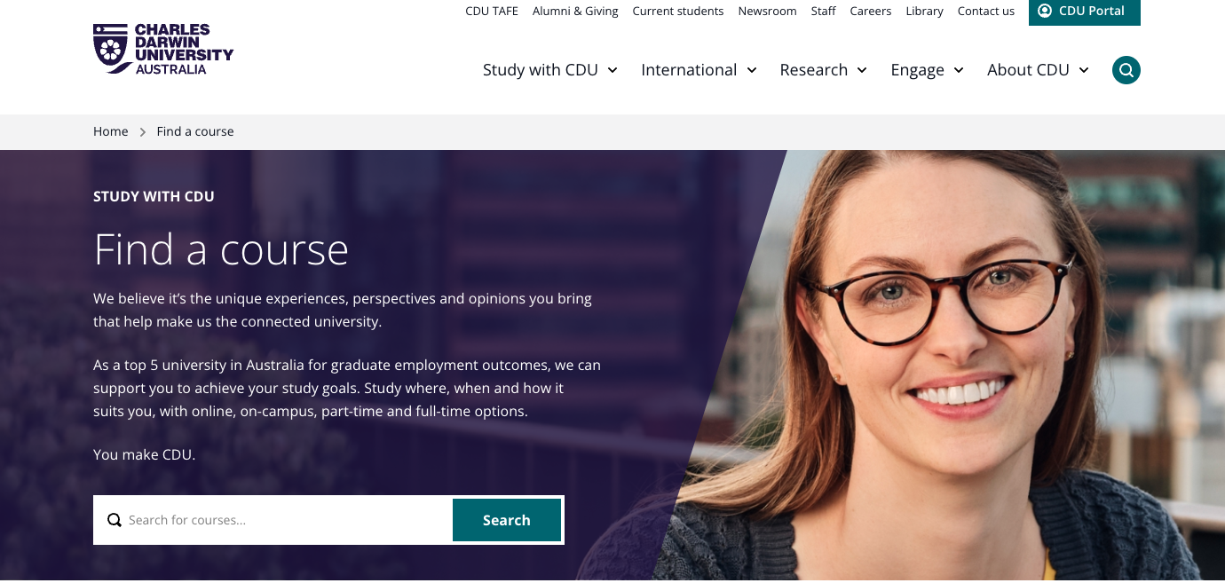
Study Plans
cdu.edu.au/study

Slide 9
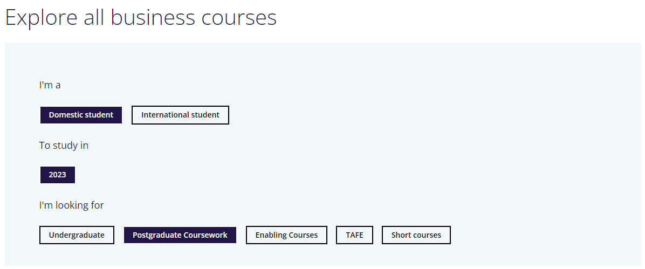
Study Plans
cdu.edu.au/study/business

Slide 10
Study Plans
cdu.edu.au/study/business

Slide 11
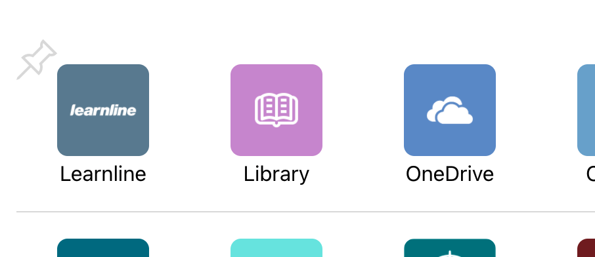
How you will learn

Slide 12
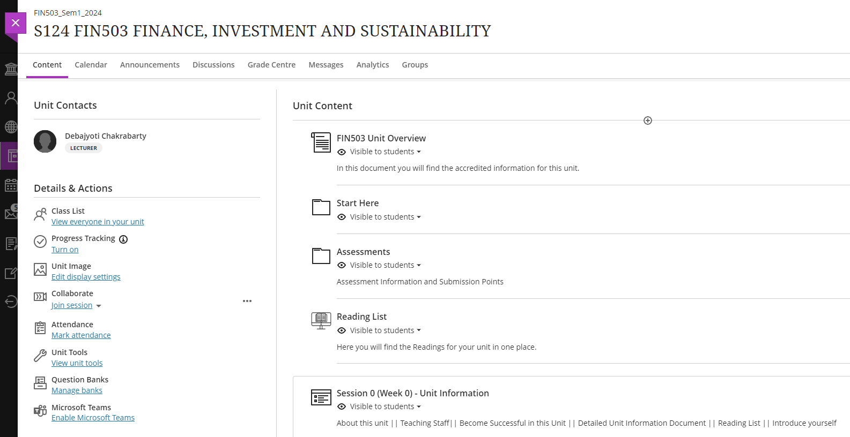
How you will learn
Have you watched the Learnline ‘how to’ session on the Orientation Website?

Slide 13
Assessments
Be sure to check the assessment details of each unit you are enrolled in.
Online quizzes, Essay questions & Exams.
All units will have a short assessment after week 3 of the semester.
Where can I go if I need help, if I don't understand my assessments? Contact your unit coordinator/lecturer.

Slide 14
Library, L&L & Learnline tools
Including how to find:
Online tutoring *Did you know that this is 24/7
Library services
Language and Learning *Booking appointments, study skills page & workshops as shown on the website
Discussion boards to connect with other students
Specific areas for the course
*Don't forget to check out the recordings/presentations on the Orientation Website under the above headings

Slide 15
Placements
You can choose to take the Professional Placement specialisation in MBA-Sustainable Enterprise/Leadership.
Specialist elective units: WIB601 (10 CP), WIB602 (10 CP) and WIB603 (20 CP).
Important: Check the study plan for this specialisation.
If you have any questions – talk to the Course coordinator

Slide 16
Important Dates / Don't forget!
Last date to enrol: 15th March 2024
Census date: 25th March 2024

Slide 17
How to get support
Course-related inquiries:​ Contact course coordinator
Email:​ debajyoti.chakrabarty@cdu.edu.au
Phone:​ 02 8047 4117
All other support:​
https://www.cdu.edu.au/current-students

Slide 18
Important tips
Attendance and Time management
Talk to your Classmates, Lecturer
Don’t be afraid to ask questions

