Slide 1
Welcome to Bachelor of Accounting (WACC02) and Bachelor of Accounting and Diploma of Law (LACCL2)

Slide 3
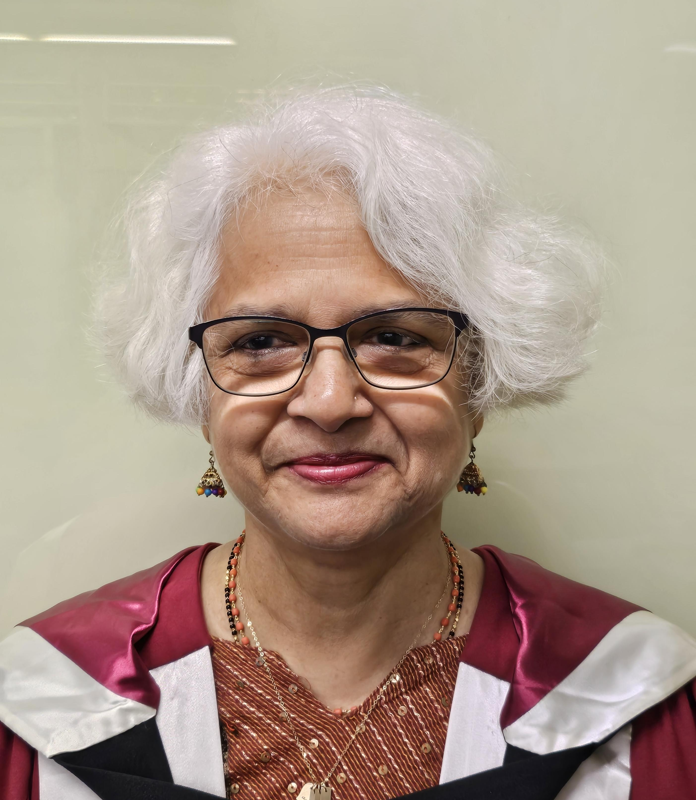
Your Course Co-ordinatror
Ms Jyoti Vemuri
Phone : 08-8946 8842
Water Front Darwin
Level 4, Room 35

Slide 4
Student Central
www: https://www.cdu.edu.au/student-central​
E: student.central@cdu.edu.au​ FAQs: Ask CDU​ 1800 061 963 (freecall)​ Mon - Thurs: 8:30am - 4pm​ Friday: 8:30am - 3pm

Slide 5
Course Aim
The COURSE Bachelor of Accounting provides a flexible qualification where you can develop your knowledge, skills , and understanding of accounting, finance, business management, communication, business law, taxation, auditing, management accounting, governance, and ethics through global and local contexts. You will be supported to be an accounting graduate with a holistic knowledge of accounting and how to apply your knowledge in real business world problem-solving.

Slide 6
What you will learn
1. The Bachelor of Accounting prepares you with professional skills to become an accountant or work in a range of roles that rely on accounting knowledge.
2. The course develops your communication, presentation, and problem-solving skills.
3. You can also choose to study business units to complement your personal interests and career options.

Slide 7
Study Plans
You may study on campus if you are an international student. If you are a domestic student you can study on campus or in external mode. However, if you have to enrol in part-time mode to study as an external student.
You need to follow your study plan to enrol in units.
As a full-time student you are required to enrol in 4 units. As a part-time student, you are required to enrol in 2 units, however, you may apply for overload.
You will find your timetable via the study plan page.

Slide 8
How you will learn
What can you find in Learnline?
Announcements, assessments, where you submit, live and recorded lectures, readings and unit guides.
*Have you watched the Learnline ‘how to’ session on the Orientation Website?​

Slide 9
Assessments
What are the expectations? i.e first 3 weeks leading to the first assessment
*Quiz, online test, essays etc.
Where can I go if I need help, if I don't understand my assessments? Unsure about how to complete a quiz, online test, write an essay etc.

Slide 10
Library, L&L & Learnline tools
Including how to find:
Online tutoring *Did you know that this is 24/7
Library services
Language and Learning *Booking appointments, study skills page & workshops as shown on the website
Discussion boards to connect with other students
Specific areas for the course
*Don't forget to check out the recordings/presentations on the Orientation Website under the above headings

Slide 11
Important Dates / Don't forget!
Last date to enrol: 15th March 2024
Census date: 25th March 2024

Slide 12
How to get support
Course-related inquiries:​ Jyoti Vemuri
Email:​ Jyoti.Vemuri@cdu.edu.au
Phone:​ 08 8946 8842
All other support:​
https://www.cdu.edu.au/current-students

Slide 13
Motivational
Top tips for success
Read the instructions in Learnline, note down dates of assessments, contact name and number of unit coordinator, library support, discussion board and grade centre
Good attendance is the key to success.

